Slide 1
ATSP Annual Report 2016
2019 Annual Report
184 Midhurst Road Gahanna, OH 43230 | info@atspnetwork.org | https://atspnetwork.org
Notes:
Gretchen- feel free to use this as a template if you like, or discard completely. It uses 2017’s Annual Report after the first 4 pages, just be aware.

Slide 2
Mission
The mission of the Association of Transcribers and Speech-to-text Providers (ATSP) is to promote excellence and integrity in the delivery of real-time speech-to-text services, by establishing a national standard of quality for transcribers and captionists, educating the public about real-time speech-to-text accommodations, strengthening networks between providers and stakeholders, and advocating for equal access to effective communication.

Slide 3
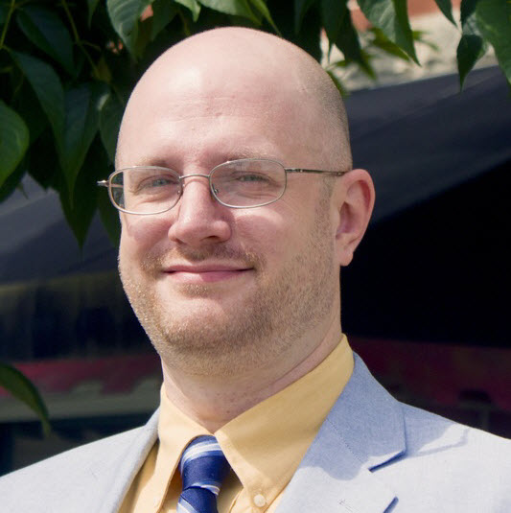
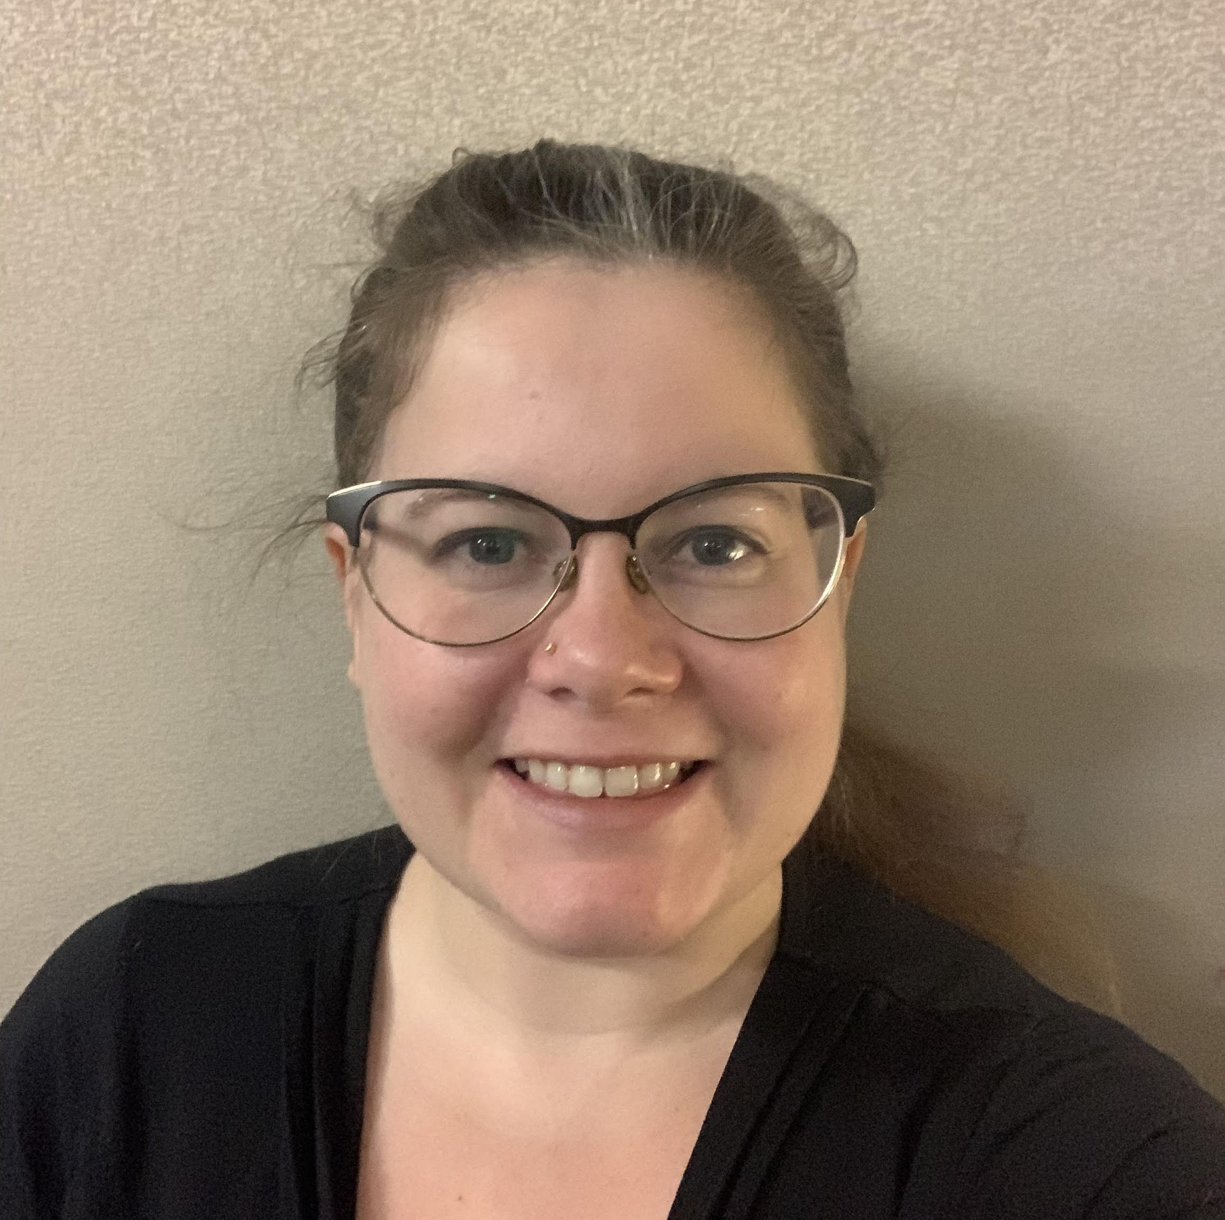
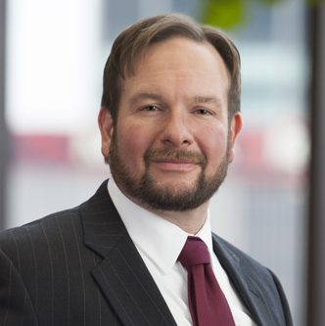
Board of Directors
Jason Kapcala
Outgoing President
Coordinator of Auxiliary Aids and Supervisor of Staff Transcriptionists and Interpreters at West Virginia University
Board President since 2016
Alison Nelson
Treasurer/Incoming President
Staff C-Print Captionist at the University of Minnesota
Board Member since 2017
Robert D. Nauman
Secretary
Attorney at Squire Patton Boggs focusing on healthcare, health insurance, and corporate matters
Board Member since 2016

Slide 4
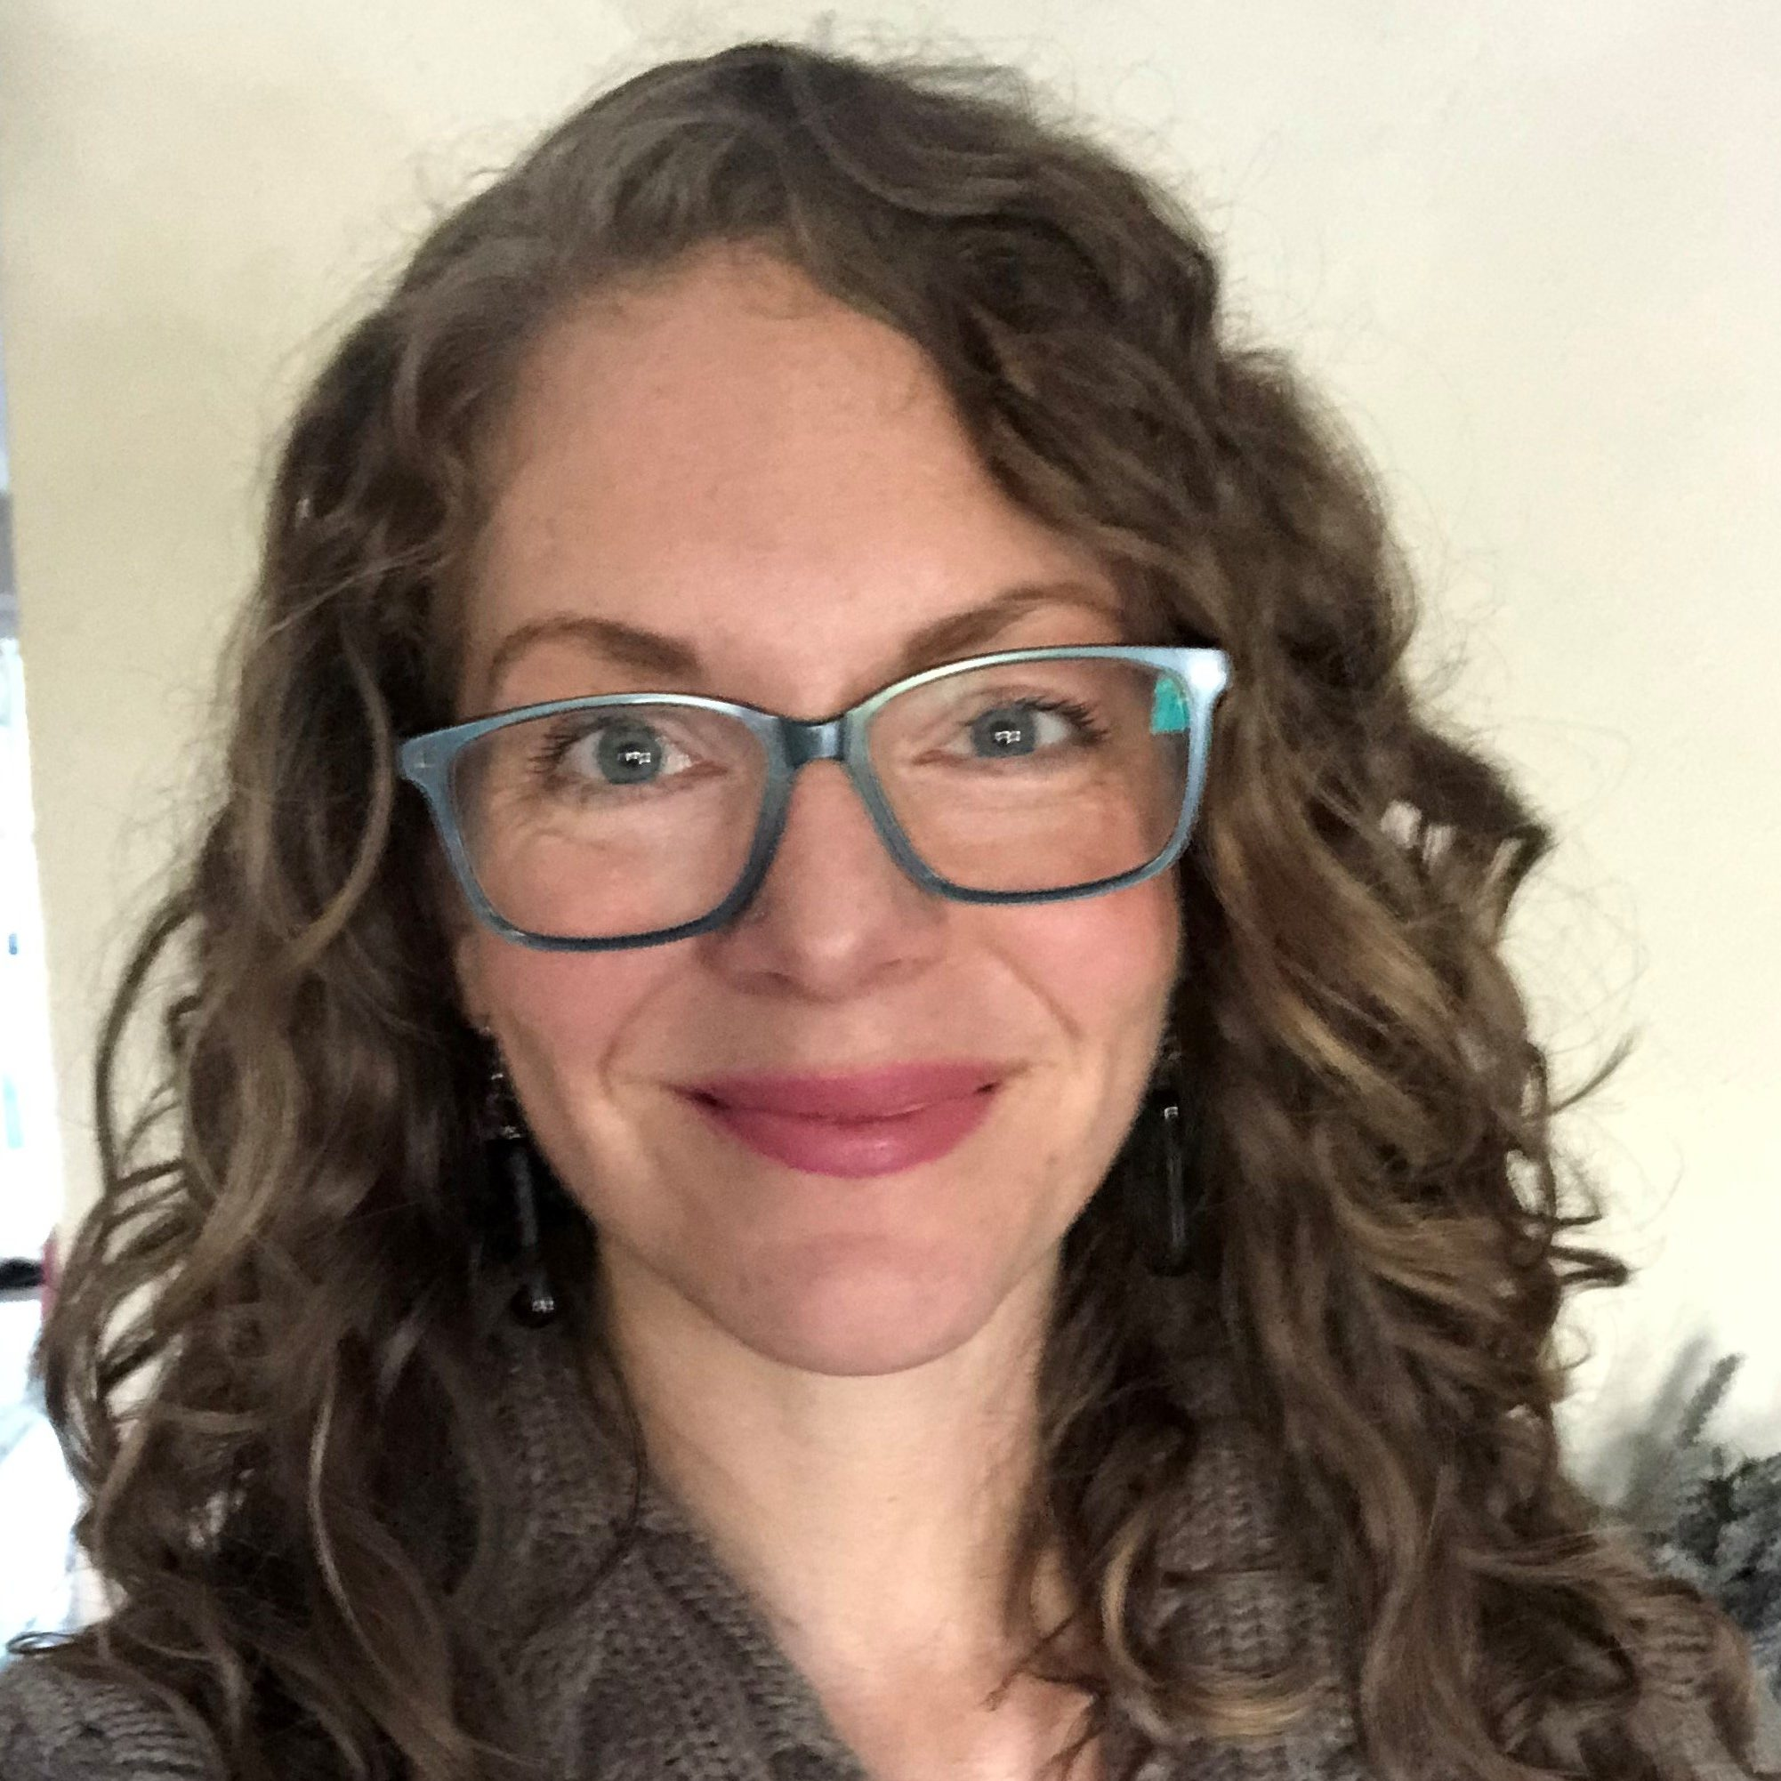
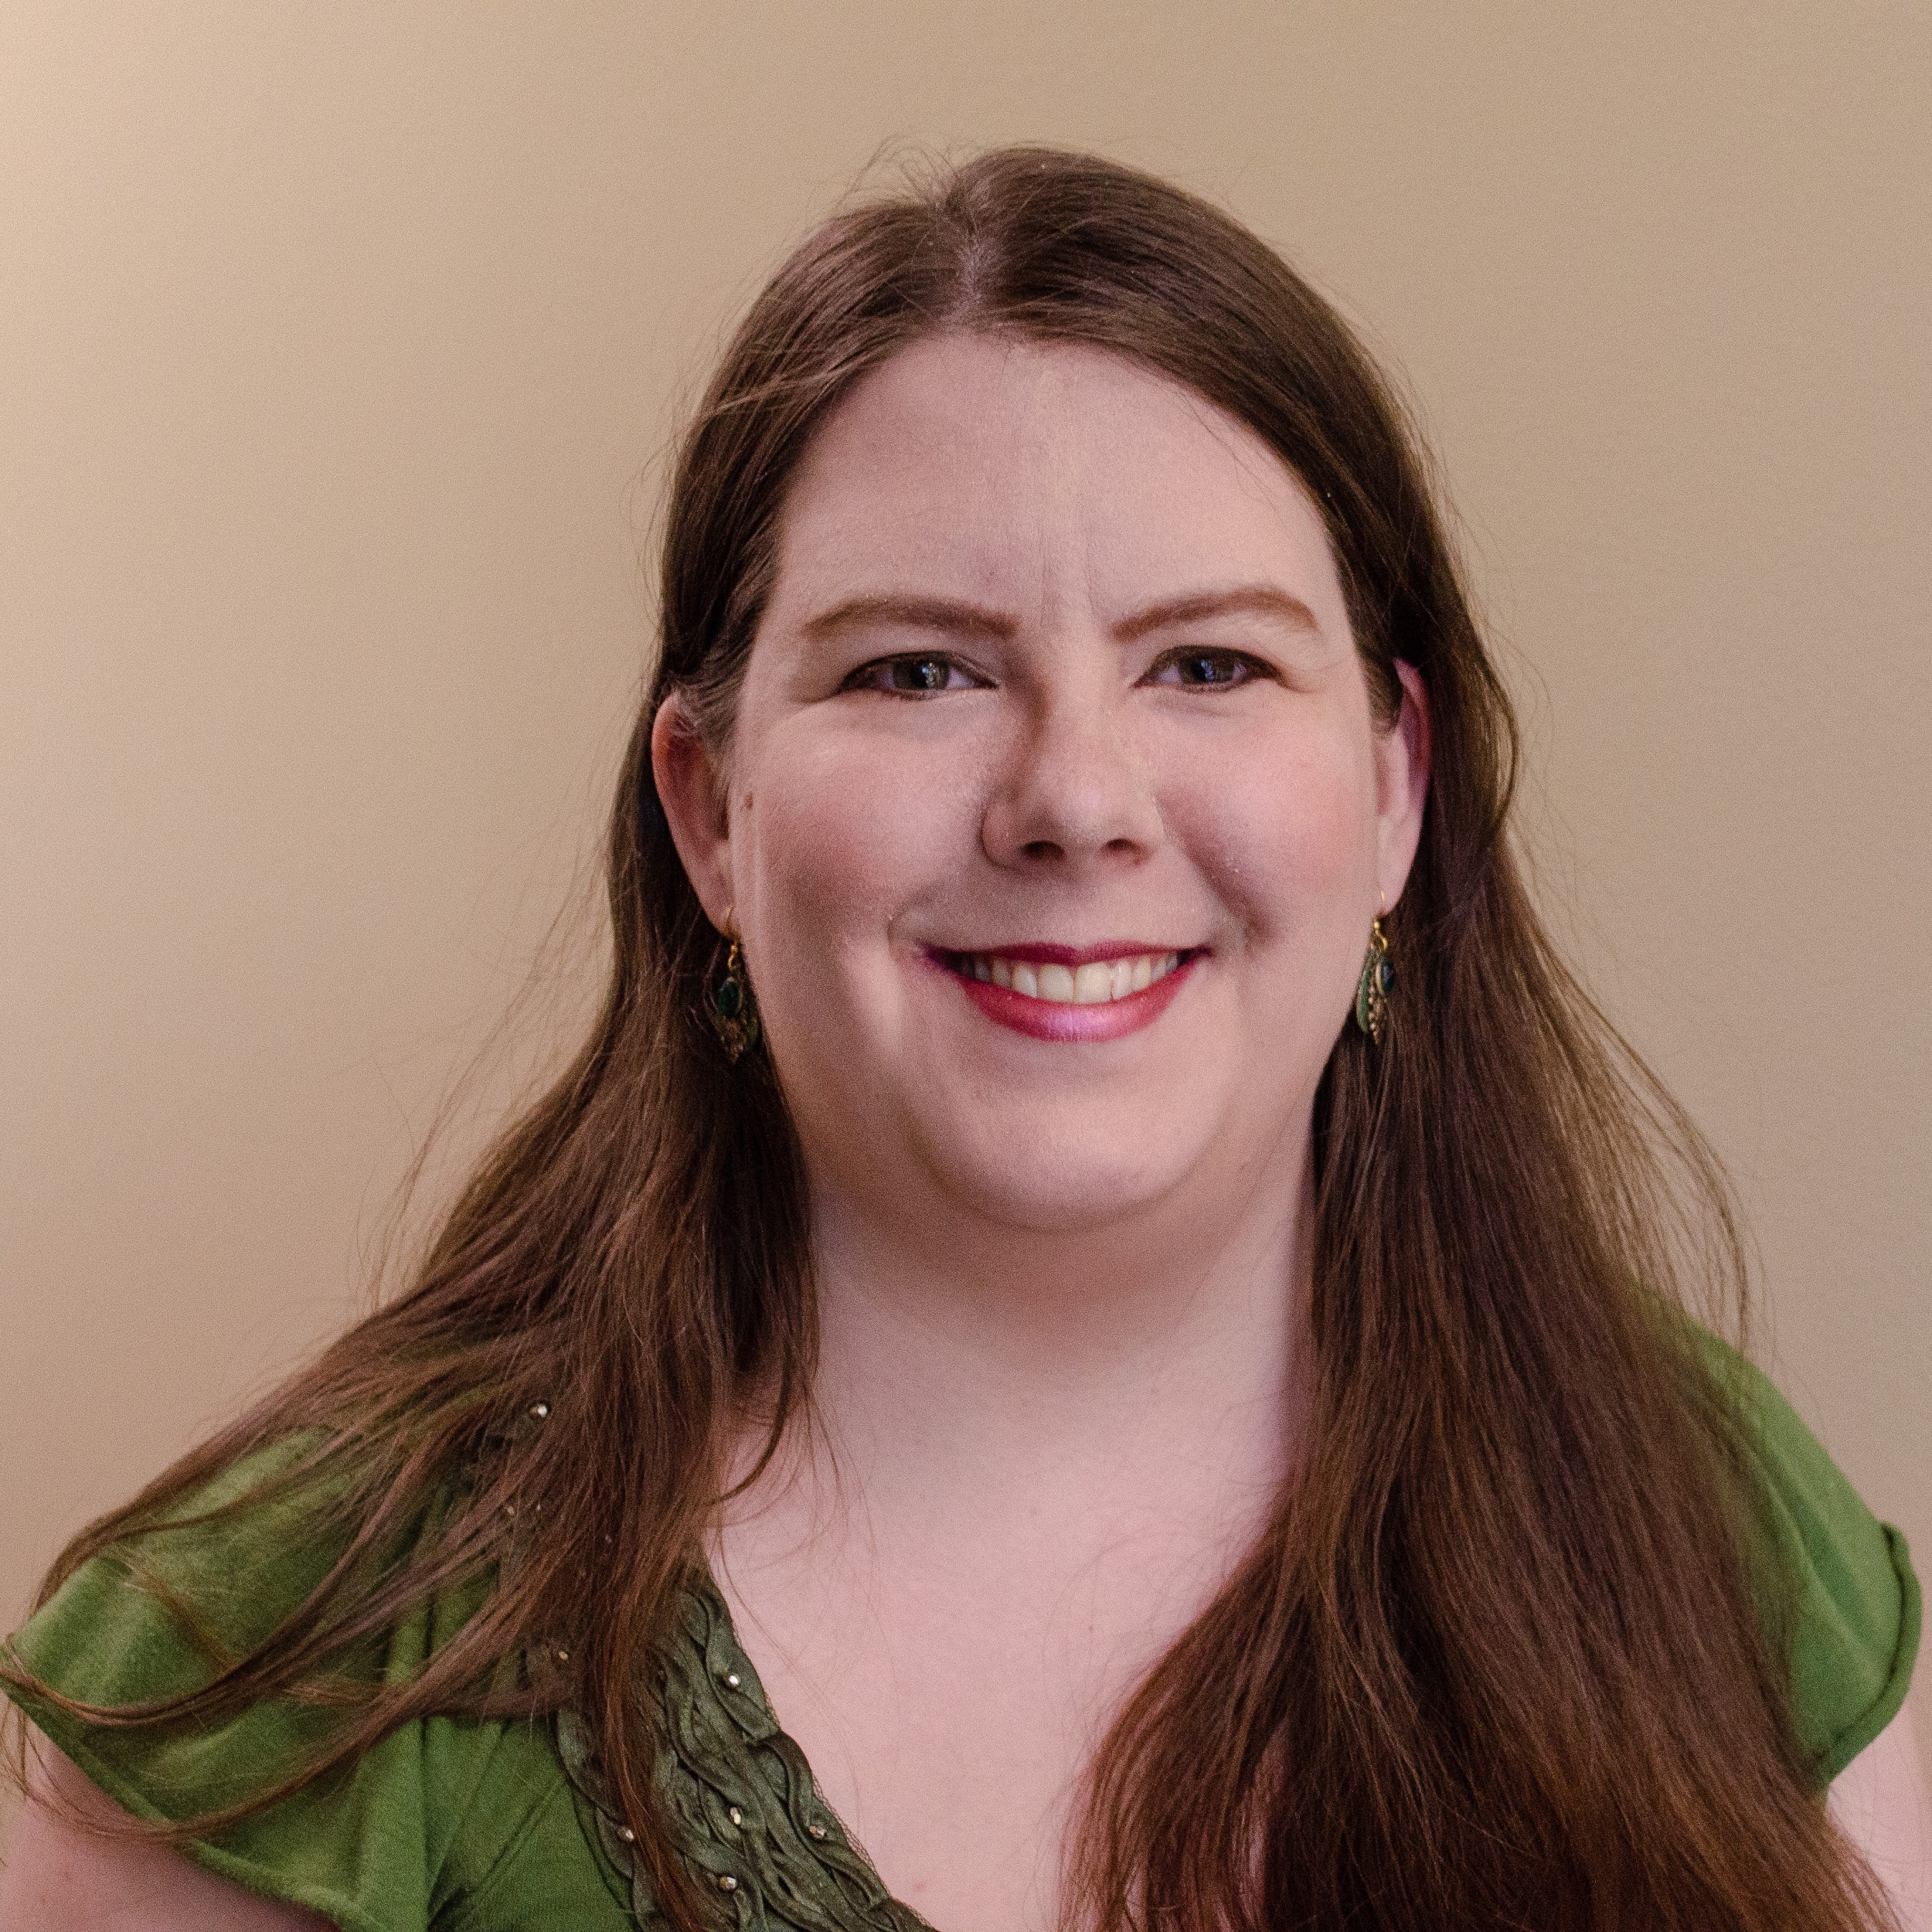
New Board Members
Gretchen Rumsey-Richardson
Vice President
Deaf and Hard-of-Hearing Services Manager
Western Washington University
Board Member since 2019
KeriAnn Hollerud
Membership Coordinator
Conceptual C-Print Captionist
Verbatim Transcriptionist
Board Member since 2019
Donovan Shanahan
Incoming Treasurer
Event & Marketing Solutions Specialist
Board Member since 2019
Tracy Fahey
Board Member
Parent of a deaf child who has chosen to live in the hearing world.
Board Member since 2019
Janet Fedorchuk
Board Member
TypeWell
Assistant Director of Education
Board Member since 2019

Slide 5
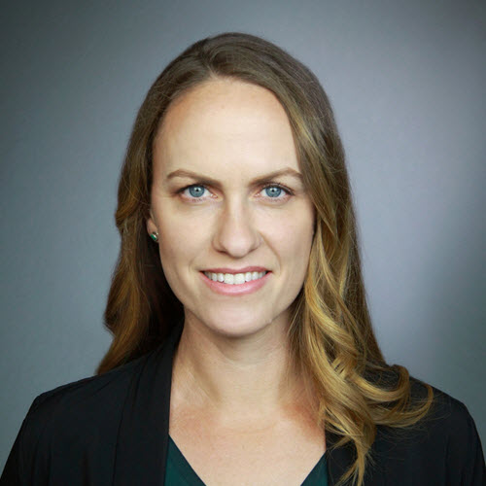
Outgoing Board Members
Kate Ervin
Board Member
TypeWell’s Director since 2011, TypeWell trainer since 2009, Transcriber since 2004.
Initial Incorporator of ATSP
Jason Kapcala
Outgoing President
Coordinator of Auxiliary Aids and Supervisor of Staff Transcriptionists and Interpreters at West Virginia University
Board President since 2016

Slide 6
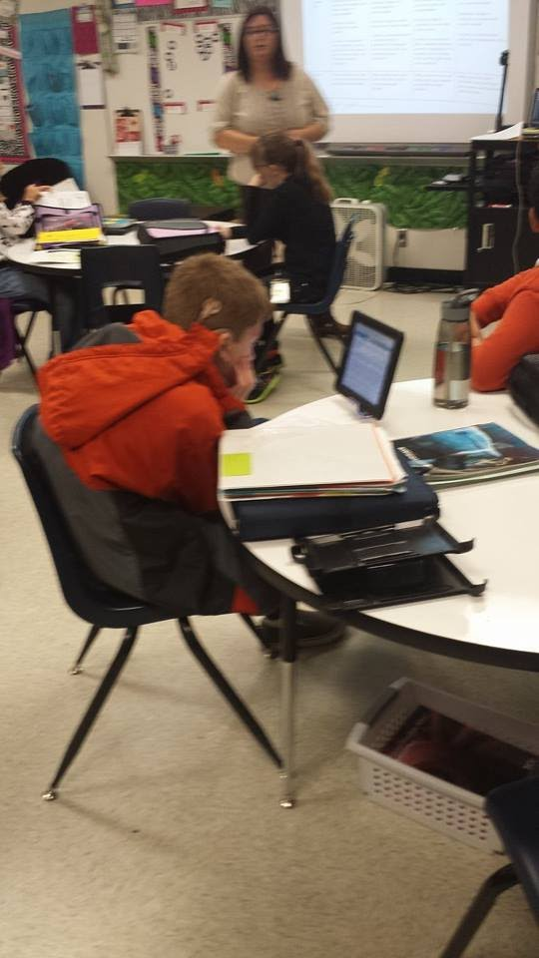
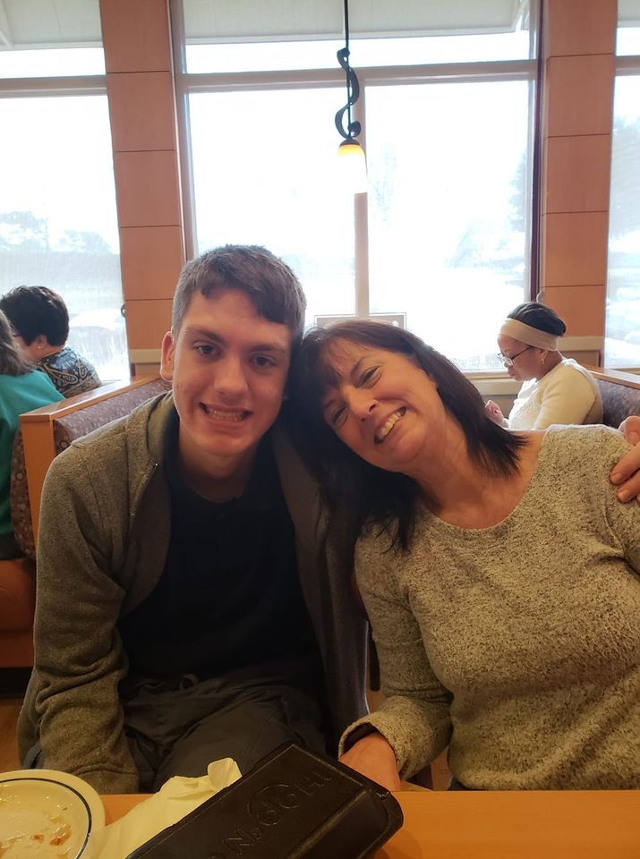
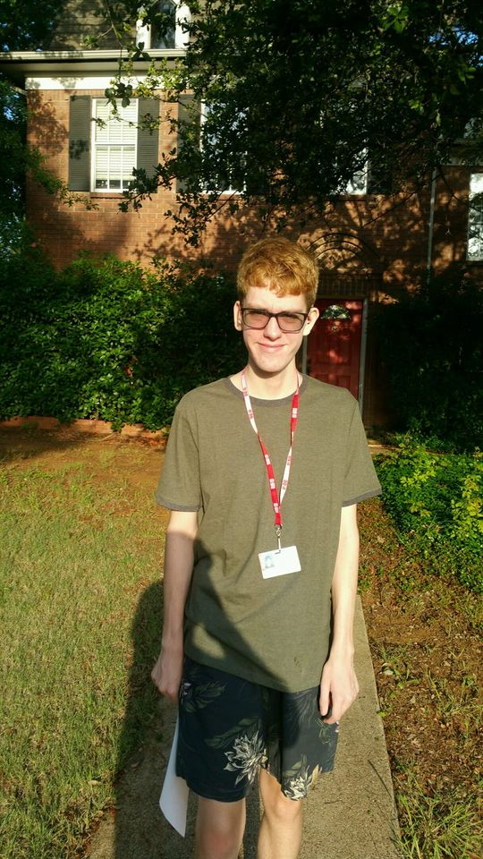
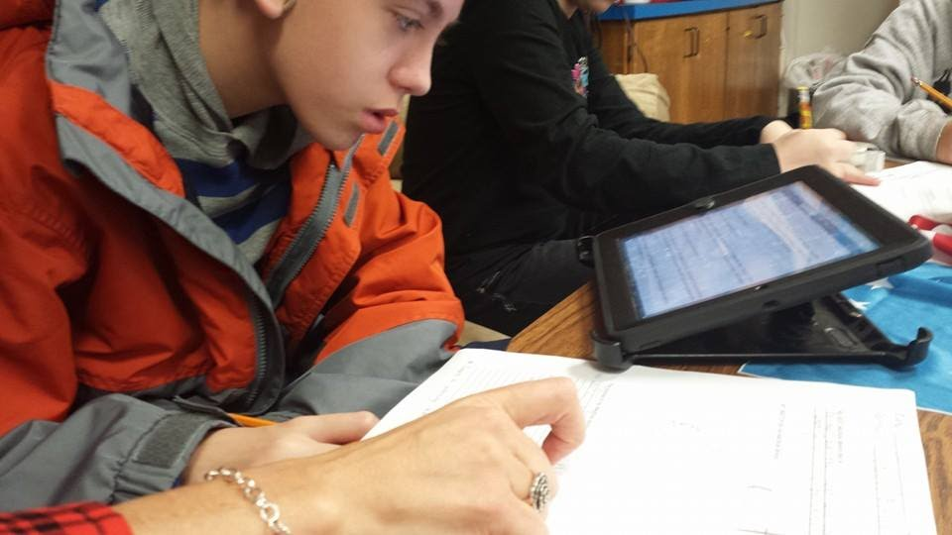
Ben’s first day with TypeWell in 5th grade
Ben with his favorite transcriber
Ben’s first time using TypeWell
“I am an oral deaf student in a mainstream high school. I have had a TypeWell transcriber that transcribes all my classes in real time since 5th grade. Without TypeWell I would not have access to my education and would not be heading to college. My transcribers are my ears!!! Thank you TypeWell.”
Ben Capellan

Slide 7
2019
2019 Achievements Pave the Way for Tomorrow
Grew and diversified ATSP Board of Directors
Established working groups for future outreaching and education projects
Completed Phase I of redesign for ATSP website and blog
Completed Phase I building legal Resources page for Speech to Text Services for Providers, Clients, and Caretakers.
Revamped ATSP bimonthly newsletter.
Continued to serve ATSP members through education, advocacy, and professional support.

Slide 8
Outgoing President’s Blurb
The past year has been one of great change and growth for ATSP. We have welcomed five new Board members onto the ATSP directorship team, and in doing so have built a strong foundation for ATSP’s future. New projects are being developed to advance ATSP’s digital footprint, its resources for stakeholders within the speech-to-text community, and its advocacy for communication access. The following report highlights these accomplishments and outlines ATSP’s goals for the upcoming year, but it is only a glimpse into the hard work and dedication of so many members working within the speech-to-text profession.
As we head into 2020 facing increased demand for services, new technological challenges, and worldwide health concerns, I believe that the existence of ATSP and organizations like it has never been more important. For the past three years, I have benefitted from the opportunity to work closely with so many strong advocates for equal rights. I transition off ATSP’s Board now, knowing that Alison and the other directors of ATSP will continue to grow the organization in new and exciting ways. ATSP is the network for all of us in the speech-to-text community, and I look forward to supporting its initiatives for many years to come.
Jason Kapcala, outbound ATSP President

Slide 9
Incoming President’s Blurb
As incoming Interim President, reading Jason Kapcala’s words on our work in 2019, I feel pride, and a little sadness. ATSP is losing a strong leader, but we are also gaining five new leaders from varied backgrounds that have brought notable change and fresh concepts to the table.
I also want to acknowledge our membership’s strength in this past year. 2019 required a lot of behind-the-scenes work to get our organization prepped for more digital and in-person programs. We laid some groundwork for our long term goals: Certification for providers, becoming a resource for consumers and providers alike, and establishing ourselves as a place of community and engagement. I know a lot of that has not been directly seen by you. It will be, soon.
Although this report is meant for 2019, I cannot write this without acknowledging your work coming into the 2020 Coronavirus pandemic, and the current anti-racism movement sweeping across our country. I am blown away by the creativity and resilience of so many minds coming together to accommodate our consumers and support each other. You have all done amazing things and are an inspiration.
I want to thank all of you for your resilience, support, and creativity. Thank you for sticking with us as we “prep” for the future of your organization.
Alison Nelson Chabot

Slide 10
2019
Membership
ATSP unifies its membership under a mission of ensuring high-quality equal access to communication. In 2019, ATSP saw a setback in membership enrollment with individual memberships dropping by 23.5% and 6.25% drop in organizational membership. There was a strengthening of the Board with the addition of five members, including a designated Membership Coordinator. With additional Board members, ATSP was able to create committees to focus on particular goals of the organization.
Since November 2016, ATSP has held 501(c)(3) non-profit status as a public charity, allowing donors to deduct contributions.

Slide 11
Finance Update
Financially, 2019 was a slow year, both for expenditures and for income. At the beginning of 2019, we started out the year with a balance of $11,193.00
Expenses incurred throughout the year were centered mainly on overhead marketing costs- continuing our website and newsletter domains, maintaining our non-profit status, maintaining insurance for members, and so forth
Revenue incurred was 20% from donations through Amazon Smile and cash/check, while the remaining revenue was from membership fees.
Because 2019 was a slow expenditure year, revenue will go to planned expenditures in 2020.

Slide 12
Finance Update
For 2020 our financial goals include saving for the heavy cost of creating and maintaining a certification program.
We plan on spending about 30% of future income creating new programs for membership engagement, benefits, education, and community building.
There will be costs associated with minor rebranding. Including but not limited to: website change, printing of marketing materials, hiring individuals and companies for design or printing needs.
We will also be utilizing funds to send our board members to industry-related conferences to present and table.

Slide 13
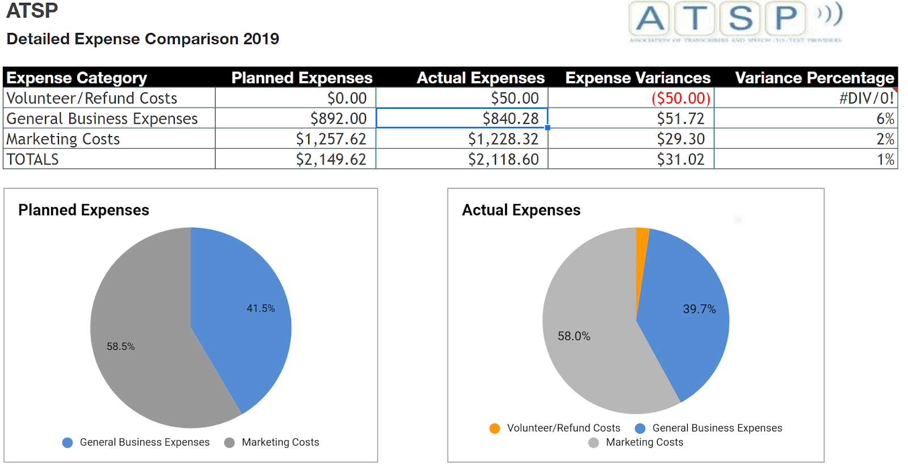
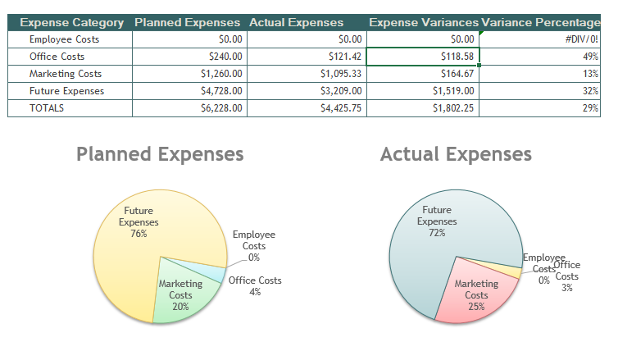
2017 ATSP Expenses

Slide 14
2019 Goals
Increase outreach to speech-to-text service providers, service agencies, schools/universities and consumers in order to promote ATSP’s mission
🡪 Efforts ongoing; ties in with 2020 rebranding efforts, increasing activism etc.
Expand educational resources through the creation of a resources page on the ATSP website, featuring opportunities for professional development and skill enhancement
🡪 Resources committee formed and currently working on assembling resources, which will be released upon the publication of our new website
🡪 Events committee formed and is working to create webinars for ATSP members (keep an eye on our social media for updates), and preparing for opportunities to table and present at in-person events post pandemic
Study speech-to-text certification to determine whether it will yield desirable results, and whether it will represent the best interests of ATSP’s members
🡪 Multi-year, ongoing project. Surveys and working groups were studied, and managers and employers were surveyed. We are comparing different options and potential partnerships to reduce potential barriers to members (i.e., cost of certification)

Slide 15
2020 Goals
Increase member engagement (recruit volunteers, logo design contest)
Rebrand ATSP and revamp digital content to meet demands of modern member (new website, new logo (contest), new colors/look
Increase activisim and presence in the disability services world (events, webniars)
Re-petition U.S. Copyright Office to continue captioning exemptions for educational institutions; expand exemption to increase captioning access beyond university students
*Much of the background work is currently being completed, but due to the pandemic, certain activities (like events) may be delayed

Slide 16
BIG Ideas
Keep sending your big ideas to info@atspnetwork.org.

